Slide 1
Instruction Set
CSE-3109 Computer Architecture Lecture 3

Slide 2
Introduction
To command a computer’s hardware, you must speak its language.
The words of a computer’s language are called instructions, and its vocabulary is called an instruction set.
The chosen instruction set comes from MIPS Technologies, which is an elegant example of the instruction sets designed since the 1980s.
MIPS (Microprocessor without Interlocked Pipeline Stages) is a reduced instruction set computer (RISC) instruction set architecture (ISA) developed by MIPS Technologies.

Slide 3
A Basic MIPS Instruction
Every computer must be able to perform arithmetic.
C code: a= b + c ;
The MIPS assembly language notation
add a, b, c
instructs a computer to add the two variables b and c and to put their sum in a.
This notation is rigid in that each MIPS arithmetic instruction performs only one operation and must always have exactly three variables.

Slide 4
A Basic MIPS Instruction
Machine code: (hardware-friendly machine instructions)
00000010001100100100000000100000

Slide 5
Example 1
Translate the following C code into assembly code:
a = b + c + d + e;
add a, b, c add a, b, c
add a, a, d or add f, d, e
add a, a, e add a, a, f
Instructions are simple: fixed number of operands (unlike C)
A single line of C code is converted into multiple lines of assembly code
Some sequences are better than others… the second Sequence needs one more (temporary) variable f

Slide 6
Example 2
C code f = (g + h) – (i + j);
Assembly code translation with only add and sub instructions:
add t0, g, h add f, g, h
add t1, i, j or sub f, f, i
sub f, t0, t1 sub f, f, j

Slide 7
Registers
In C, each “variable” is a location in memory
Unlike programs in high-level languages, the operands of arithmetic instructions are restricted; they must be from a limited number of special locations built directly in hardware called registers.

Slide 8
Registers
To simplify the instructions, we require that each instruction (add, sub) only operate on registers
One major difference between the variables of a programming language and registers is the limited number of registers, typically 32 on current computers, like MIPS.

Slide 9
Registers-Cont.
Each register is 32-bit wide (modern 64-bit architectures have 64-bit wide registers)
A 32-bit entity (4 bytes) is referred to as a word
Although we could simply write instructions using numbers for registers, from 0 to 31, the MIPS convention is to use two-character names following a dollar sign to represent a register.

Slide 10
Registers-Cont.
we will use $s0, $s1, . . . $s7 for registers that correspond to variables in C and Java programs and $t0, $t1, . . . $t9 for temporary registers needed to compile the program into MIPS instructions.

Slide 11
Example 3
C code f = (g + h) – (i + j);
The variables f, g, h, i, and j are assigned to the registers $s0, $s1, $s2, $s3, and $s4, respectively.
add $t0,$s1,$s2
add $t1,$s3,$s4
sub $s0,$t0,$t1

Slide 12
Memory Operands
The processor can keep only a small amount of data in registers, but computer memory contains billions of data elements.
Hence, data structures (arrays and structures) are kept in memory.
Arithmetic operations occur only on registers in MIPS instructions; thus, MIPS must include instructions that transfer data between memory and registers.
Such instructions are called data transfer instructions.

Slide 13
Memory Operands-Cont.
To access a word in memory, the instruction must supply the memory address.
Address: A value used to define the location of a specific data element within a memory array.
Memory is just a large, single-dimensional array, with the address acting as the index to that array, starting at 0.
Memory is byte addressed: each address identifies an 8-bit byte.

Slide 14
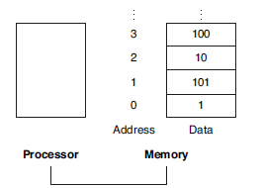
Memory Operands-Cont.
For example, in Figure, the address of the third data element is 2, and the value of Memory[2] is 10.

Slide 15
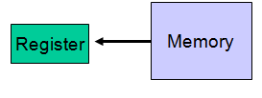
Memory Operands-Cont.
The data transfer instruction that copies data from memory to a register is traditionally called load.
The actual MIPS name for this instruction is lw, standing for load word.
lw $t0, memory-address

Slide 16
Memory Operands-Cont.
The instruction complementary to load is traditionally called store; it copies data from a register to memory. The actual MIPS name is sw, standing for store word.
Keep in mind that memory is byte-addressable, so a 32-bit word actually occupies four contiguous locations (bytes) of main memory.

Slide 17
Memory Operands-Cont.
The MIPS architecture requires words to be aligned in memory; 32-bit words must start at an address that is divisible by 4.
0, 4, 8 and 12 are valid word addresses.
1, 2, 3, 5, 6, 7, 9, 10 and 11 are not valid word addresses.

Slide 18
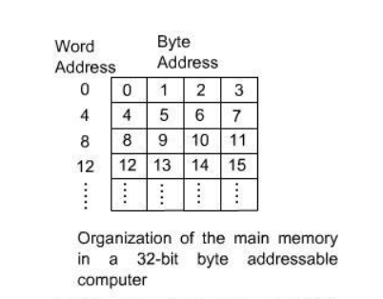
Memory Operands-Cont.

Slide 19
Memory Operands-Cont.
Let’s assume that A is an array of 100 words and that the compiler has associated the variables g and h with the registers $s1 and $s2.
Let’s also assume that the starting address, or base address, of the array is in $s3. Compile this C assignment statement:
g = h + A[8];
Although there is a single operation in this assignment statement, one of the operands is in memory, so we must first transfer A[8] to a register.

Slide 20
Memory Operands-Cont.
The address of this array element is the sum of the base of the array A, found in register $s3, plus the number to select element 8.
The data should be placed in a temporary register for use in the next instruction.
C Code: g = h + A[8];

Slide 21
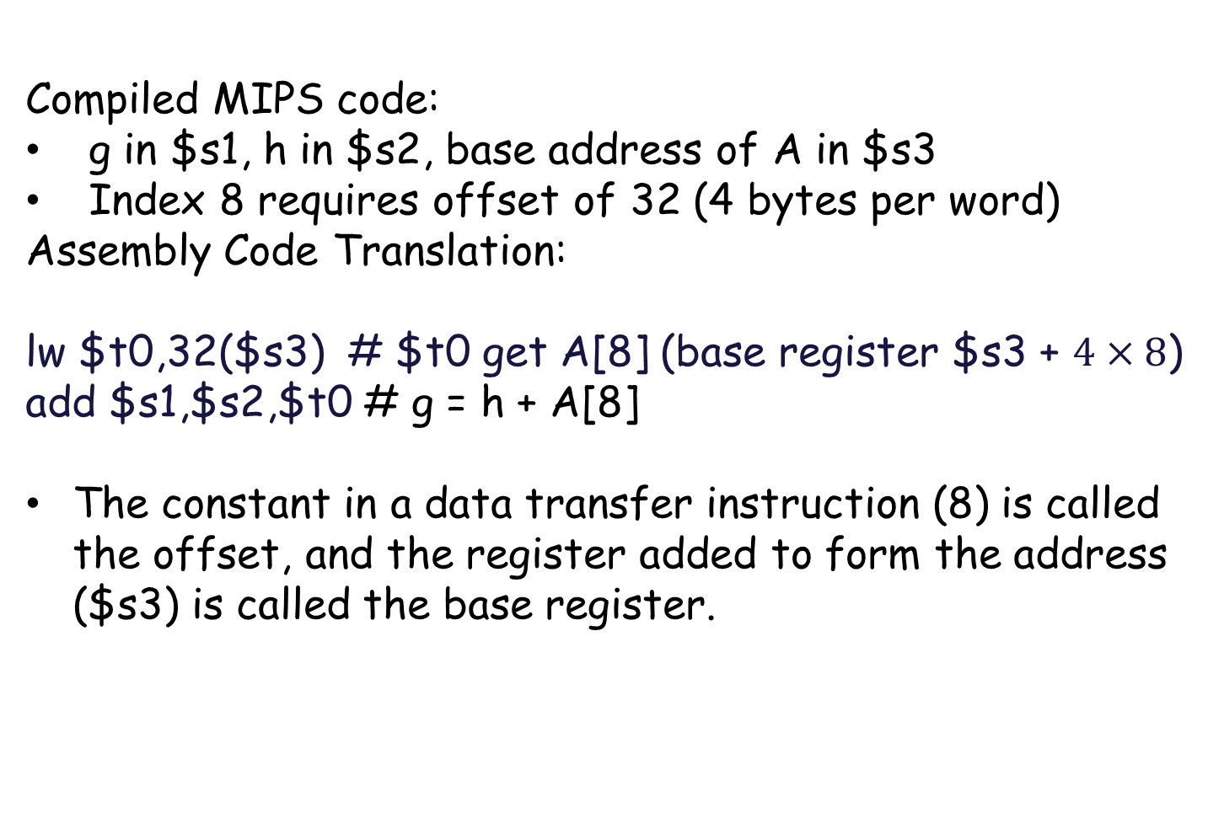
Memory Operands-Cont.
Compiled MIPS code:
g in $s1, h in $s2, base address of A in $s3
Index 8 requires offset of 32 (4 bytes per word)
Assembly Code Translation:
lw $t0,32($s3) # $t0 get A[8] (base register $s3 + $4×8$)
add $s1,$s2,$t0 # g = h + A[8]
The constant in a data transfer instruction (8) is called the offset, and the register added to form the address ($s3) is called the base register.

Slide 22
Memory Operands-Cont.
Byte addressing also affects the array index. To get the proper byte address in the code above, the offset to be added to the base register $s3 must be 4 × 8, or 32, so that the load address will select A[8] and not A[8/4].

Slide 23
Example
Assume variable h is associated with register $s2 and the base address of the array A is in $s3. What is the MIPS assembly code for the C assignment statement below?
A[12] = h + A[8];
Compiled MIPS code:
h in $s2, base address of A in $s3
Index 8 requires offset of 32
lw $t0,32($s3) # $t0 gets A[8]
add $t0,$s2,$t0 # $t0 gets h + A[8]
sw $t0,48($s3) # $ Store h + A[8] back into A[12]

Slide 24
Constant or Immediate Operands
An instruction may require a constant as input
An immediate instruction uses a constant number as one of the inputs (instead of a register operand)
To add 4 to register $s3, we just write
addi $s3,$s3,4

Slide 25
Example
Convert to assembly:
C code: d[3] = d[2] + a;
Assembly:
lw $t0, 8($s4) # d[2] is brought into $t0
addi $t0, $t0, a # the sum is in $t0
sw $t0, 12($s4) # $t0 is stored into d[3]
Assembly version of the code continues to expand!

Slide 26
MIPS register 0 ($zero)
MIPS register 0 ($zero) is the constant 0. It cannot be overwritten.
add $t2, $s1, $zero # $t2 gets $s1

Slide 27
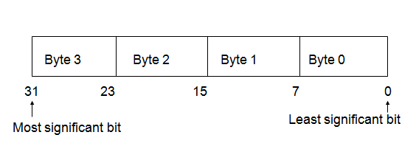
Byte Storage

Slide 28
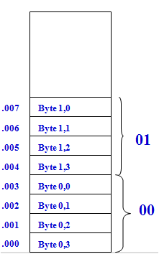
Big-Endian Storage Method
Suppose a word W_{i} is represented as B_{i, 3} B_{i, 2} B_{i, 1} B_{i, 0}
Most significant byte B_{i, 3} of W_{i} is assigned the lowest address and the least significant byte B_{i, 0} is assigned the highest address.
It is so named because it assigns highest address to byte 0 of a word.

Slide 29
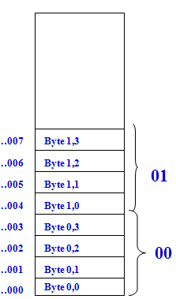
Little-Endian Storage Method
Suppose a word W_{i} is represented as B_{i, 0} B_{i, 1} B_{i, 2} B_{i, 3}
Most significant byte B_{i, 3} of W_{i} is assigned the highest address and the least significant byte B_{i, 0} is assigned the lowest address.
It is so named because it assigns lowest address to byte 0 of a word.

Slide 30
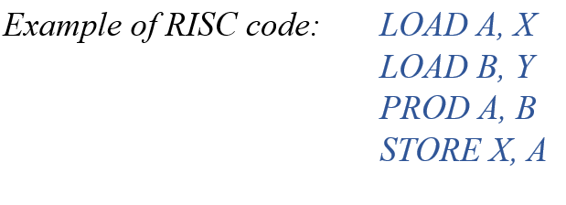
RISC
It stands for Reduced Instruction Set Computer. It is a type of microprocessor architecture that uses a small set of instructions of uniform length. These are simple instructions that are generally executed in one clock cycle. RISC chips are relatively simple to design and inexpensive. The main idea behind this is to make hardware simpler by using an instruction set composed of a few basic steps for loading, evaluating, and storing operations just like a load command will load data, a store command will store the data.
(Multiply value in memory location “X” by value in memory location “Y”; Store back into location “X”. Registers “A” and “B” are available.

Slide 31
CISC
It stands for Complex Instruction Set Computer. These processors offer the users, hundreds of instructions of variable sizes. CISC architecture includes a complete set of special-purpose circuits that carry out these instructions at a very high speed. These instructions interact with memory by using complex addressing modes. The main idea is that a single instruction will do all loading, evaluating, and storing operations just like a multiplication command will do stuff like loading data, evaluating, and storing it, hence it’s complex.
Example of CISC code: IMUL X, Y

Slide 32
A*B: RISC vs CISC
CISC instruction:
MUL A, B
RISC instructions:
LOAD A, R1
LOAD B, R2
MUL A, B
STORE R3

Slide 33
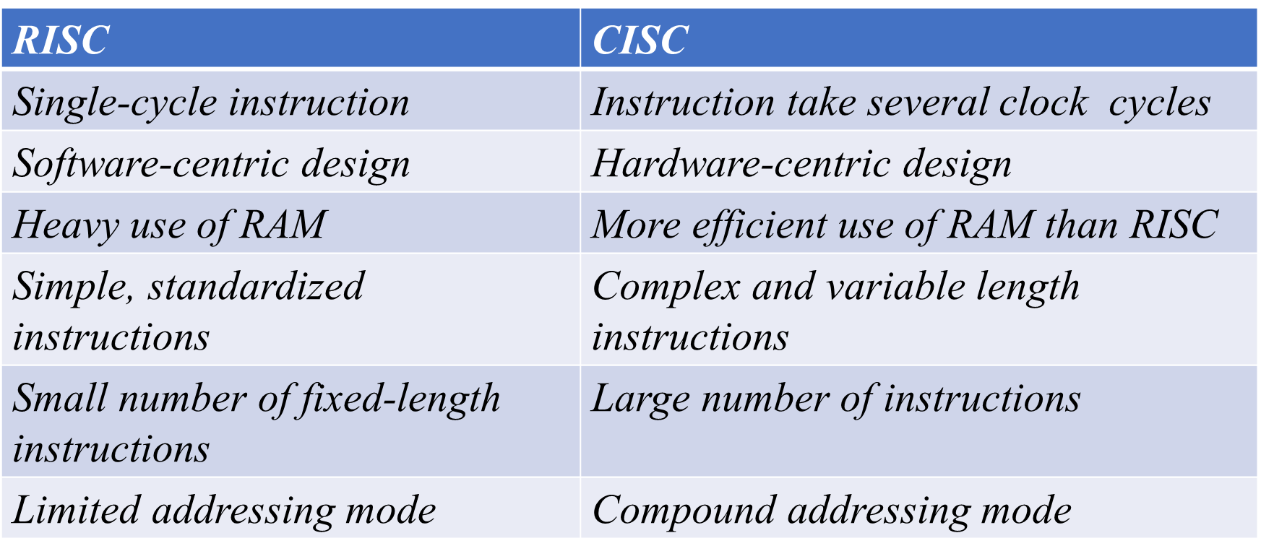
RISC vs CISC

Slide 34
End

